Slide 1
Olympus Product Backlog showing Sprint 1
Paste a copy of your Product Backlog, showing a minimum of Sprint 1. Pls highlight Sprint 1 in a red box.
This can be a modified version of the Product Backlog that you previously submitted. Pls ensure that Story Points add up to the approx. velocity and that the items delivered are tangible.
I suggest including only 3 items in the Product Backlog (as in my example) to ensure the Sprint Task Board is manageable.

Slide 2
Sprint Task Board (day 10)
Stories
Not Started
In Progress
Complete
(task)
(number)
(task)
(number)
(task)
(number)
PBI #1
(text)
(story points)
(task)
(number)
PBI #2
(text)
(story points)
(task)
(number)
(task)
(number)
PBI #3
(text)
(story points)
(task)
(number)
Outlet for (task)
(number)
(task)
(number)

Slide 3
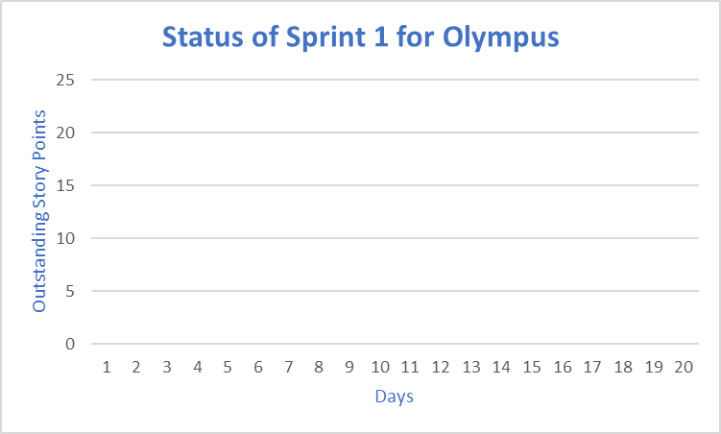
On day 10, there are ?? outstanding story points, ?? have been completed.

